Slide 1
Web Crawler
Python Class #9
HEHology

Slide 2

Web Crawler
A bot that searches through the www
Gets url
Copies everything on that site

Slide 3
Selenium
Gets HTTP requests
See your current status

Slide 4
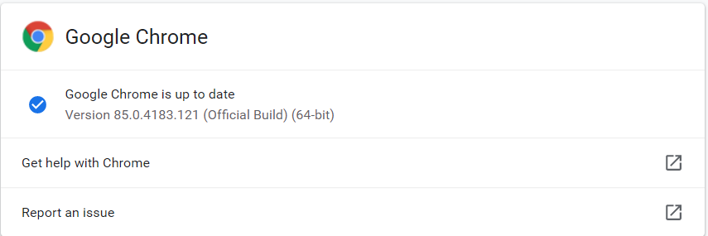
Selenium-Getting Started
Create your project
Terminal
pip install selenium
https://sites.google.com/a/chromium.org/chromedriver/home
chrome://settings/help
If you have windows, download chromedriver_win32.zip
Move your downloaded file to your project file
Right click to extract

Slide 5
bs4
Searcher in HTML
It’s convenient
Navigating
Searching

Slide 6
Web Crawler
Labels
<div…>
<img…>
Attributes
alt=
src=
width=

Slide 7
bs4-Getting Started
Terminal
pip install bs4

Slide 8
bs4-Using
from bs4 import BeautifulSoup
url = 'https://www.google.com/'
driver = webdriver.Chrome()
driver.get(url)
web = driver.page_source
soup = BeautifulSoup(web, 'html.parser')
image = soup.find('img')
print(image)
link = image['src']
driver.close()
print(url + link)

Slide 9

Thanks!
Any questions?
HEHology

